Slide 1
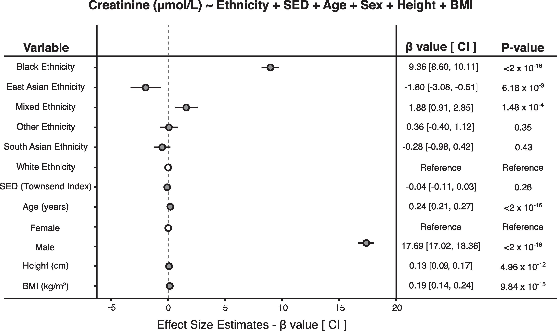
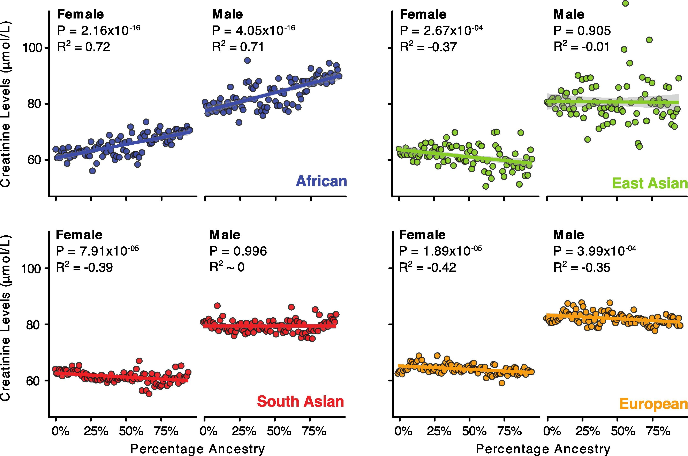
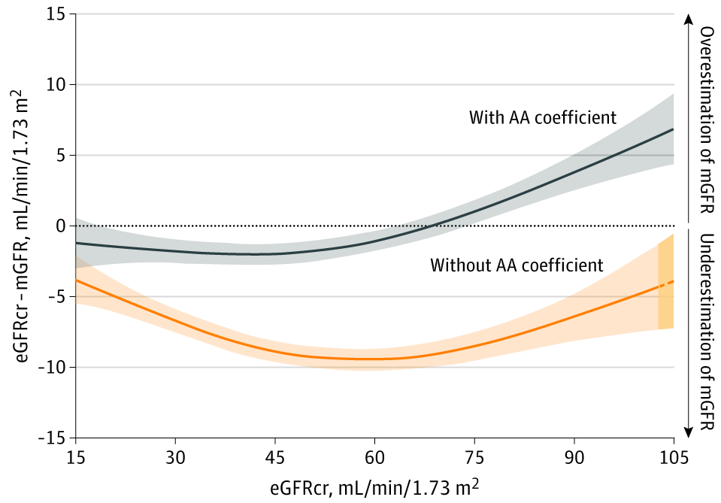
When Race Matters in Medicine: The Case of Estimating GFR Joel Velasco, Brad Snodgrass
Texas Tech University
What is GFR?
Explanation of
Higher Creatinine?
The glomerular filtration rate (GFR) measures the rate at which your kidneys are filtering your blood.
Direct measurements (mGFR) are difficult and intense (e.g. IV introducing inulin and collecting all urine for 24 hours).
Standard method estimates GFR from creatinine levels – a waste product produced in muscles. So concentration depends not just on kidney function, but on production levels which vary between individuals.
From 1999 to 2021 the recommended estimation equation used serum creatinine along with age, sex, and race to estimate GFR.
In July 2020, the National Kidney Foundation and the American Society of Nephrology create a joint task force “to reassess the inclusion of race in eGFR.”
Sept 2021 - Task Force recommends removal of the race correction factor. New refit equation is calculated from the same data as if the race of the patients was unknown. Statistically, patients are treated as a weighted average of Black/non-Black (in a heavily biased sample of 31% black patients).
1) Higher muscle mass (?)
2) Genetics
-- It doesn’t really matter --
Joint Task Force
Mariño-Ramírez et al. GENE 2022
Why Recommend Removal?
“The rationale for the Task Force includes the following: race is a social and not a biological construct, the problematic nature of applying race to clinical algorithms, and the need to advance health equity and social justice.”
-- The task force was looking for the best way to estimate GFR without using race. Unlike earlier studies, this decision was made ahead of time independent of the data.
-- But racial justice demands appropriate medical care – not a racially blind form of equality. (Compare the cases of pulse ox measurements and metformin contraindication.)
Why use Race?
1976 - Cockcraft Gault equation used just age, sex, and weight [and was calibrated on 236 white men].
1999 - First large-scale study was MDRD – 1,628 diverse patients all with kidney disease. Best predictive variables were age, sex, race. Creatinine levels were 18% higher in Black patients than non-Blacks holding fixed mGFR.
Note that Race was added as a RESULT of the data, not built-in ahead of time.
2009 – CKD-EPI looks at 13,758 patients – race ‘correction factor’ reduced to 16% but still used.
Consequences of the New Refit Equation
1) 5.51 million non-Black patients with chronic kidney disease (CKD) now don’t have it
2) 5.49 million non-Black patients have a lesser degree of CKD
3) 434,000 Black patients now with CKD
4) 584,000 Black patients now with a more advanced form of CKD
5) Black patients given extra time (moved up) on the kidney transplant list
6) Black patients with lower eGFR scores eligible for more kidney care BUT now contraindicated for a variety of drugs with interaction effects (ACE inhibitors, beta blockers, metformin…)
7) Non-Black patients have the opposite effects (less kidney care, more drug availability)
Accuracy Before and After
Accuracy With and Without Race Correction
Conclusion
Inker et al. NEJM 2021
These individuals should be reclassified if this is based on more accurate estimates. -- But the new equation is known to be LESS accurate. So these changes are medically inappropriate and morally problematic.
Levey et al. JAMA 2020

